Slide 1
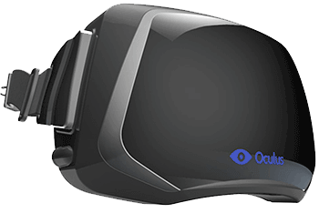

Slide 2
Applications of
Virtual Reality for the AEC Industry
Presented by :
Mr. John Rewolinski
VDC Industry Pioneer

Slide 3
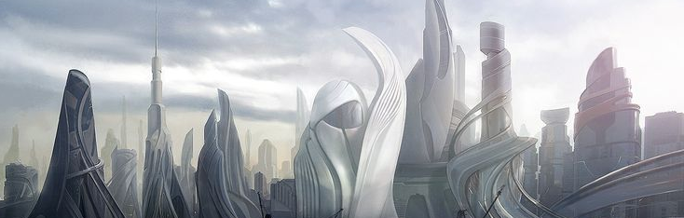
History of BIM
2006
BIM and 3D modelled projects reach 25% industry adoption.
2012
BIM reaches 80% industry adoption
1982
AutoCAD is released
2000
Revit is released to create the first “BIM” system.
2009
BIM reaches 50% industry adoption.
2016
VR technology is available commercially

Slide 4
Components of VR
3D Model
(Revit, Sketchup)
Information
(Materials, Cost, Schedule)
VR
System
3D
Engine
VR
Headset
Function
(Lights, Elevators,
Equipment)

Slide 5
VR Process
The VR Process is fairly simple to take a design from concept to presentation
Model
Information
Programming
Present
1
2
3
4
Design Team Conceptualizes
As soon as the design team has come up with a conceptual design in 3D a VR model can be created
Building Information Established
Functionality and information are added to the model.
VR Engine Programming
All of the components are imported to the VR Engine and processed for presentation.
VR Model Presentation
The VR model is presented to internal and external stakeholders.

Slide 6
Current
Limitations of VR
Technological
As with all new technology, there are some limitations to the VR System for Applications in BIM. These limitations will dissipate as the technology advances.
Practical
There are also some practical limitations which may not be solved with time.
The complexity of Revit models can be too much for the system
It is hard to focus on the VR model if you have bad vision.
Model clarity depends on hardware used and skillset of the developer
Some VR equipment wearers report motion sickness when walking.
Very few construction professionals with VR experience
Technology may seem too “futuristic” for widespread adoption by traditional construction professionals

Slide 7
How much
Does VR Cost?
VR is incredibly cost effective given the benefits, and falls in line with other short term professional services.
~$150/hr – Professional Services
The cost of professional services is in line with other similar consultants. Though VR projects take a fraction of the time.
$1000 - Equipment
The VR equipment and the cost of the VR engine

Slide 8
Benefits of VR Implementation
Improved Communication
Limit miscommunication and receive faster owner acceptance, faster review times and greater clarity of scope.
Business Development
Competitive advantage and greater communication of vision, especially for architecture and design/build firms.
Cost/Schedule Savings
Reduce the cost and schedule impacts due to change orders, issue resolution and design flaws.
Public Outreach
Communicate your vision more effectively to community stakeholders.
Stay Cutting Edge
VR implementation proves that a firm is willing to stay cutting edge to provide the best services for their client.

Slide 9
Capabilities of VR
Show Construction Over Time in 3D
Similar to 4D scheduling software, the VR construction model can be attached to a schedule to show construction development over time.
Integrated Cost Data
Show costs of components, assemblies, and equipment while looking at the project.
Remote Jobsite Walkthroughs
With Drone LADAR scanning or a 3D camera, remotely view jobsite progress in geographically diverse programs.
Show Projects in Operation
Able to virtualize operations, such as a functioning transit system, manufacturing process, or pre-sell residential/retail space.

Slide 10
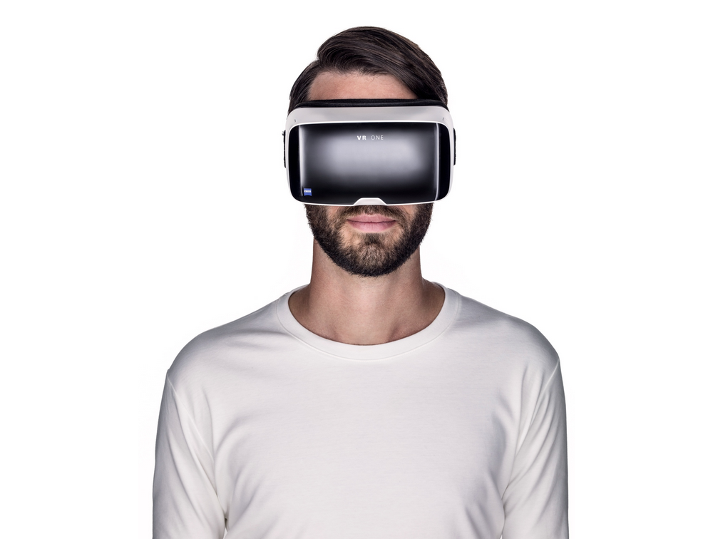
Contact Me
If you would like to speak further regarding Virtual Reality for the Architecture, Engineering & Construction Industry, please feel free to contact me.
Phone
Mobile : 541-621-1533
Email
me@johnrewolinski.com

Slide 11
Questions?
Thanks for Your Time

